Slide 1
NBA Success From a Data Point of View
Joe Uva, Mateus Arruda, Scott Sanders, Ulrich Matthis

Slide 2
What determines if an NBA is successful or not?
Win Percentage?
Championships?
Finances?
Team Marketability?
Fan Engagement?

Slide 3
All of these have an effect on a team

Slide 4
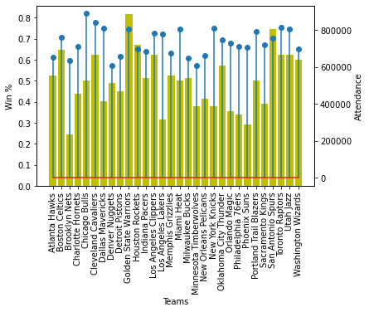
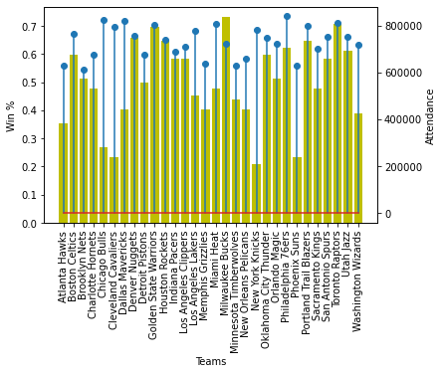
How Does Performance Effect Attendance

Slide 5
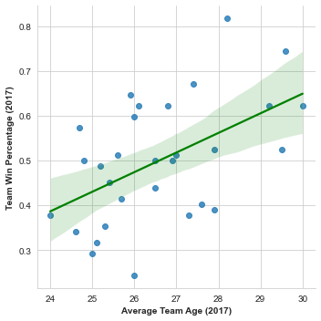
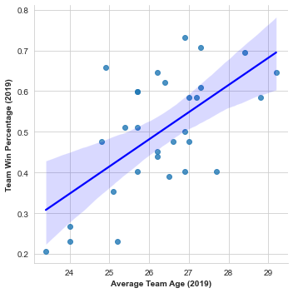
Regress-Line (2017):
Regress_Line (2019):

